Slide 1


iCLEF 2009 overview tags: image_search, multilinguality, interactivity, log_analysis, web2.0
Julio Gonzalo, Víctor Peinado,
Paul Clough & Jussi Karlgren
CLEF 2009, Corfu
Notes:
1
Dealing with social networks and folksonomies → tags for the title
Las iCLEF (everyone goes user-oriented) → looking back

Slide 2
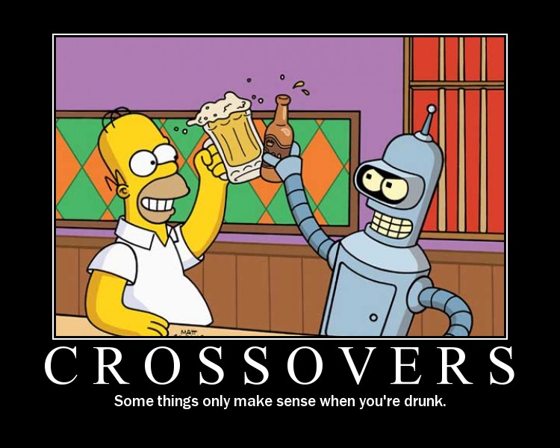
What CLIR researchers assume
User needs information.
Machine searches.
User is happy (or not).
Notes:
2
Biggest failure: you still think that
Doug Oard’s idea: interactive point of view

Slide 3
But finding is a matter of two
Fast
stupid
smart
slow
Room for collaboration!
Notes:
3
10 years later, we only doubt about the “smart” bit.

Slide 4
“Users screw things up”
Can’t be reset
Differences between systems dissappear
Differences between interactive systems too!
Who needs QA systems having a search engine and a user?
Notes:
Interactive IR a difficult area from the point of view of evaluation

Slide 5
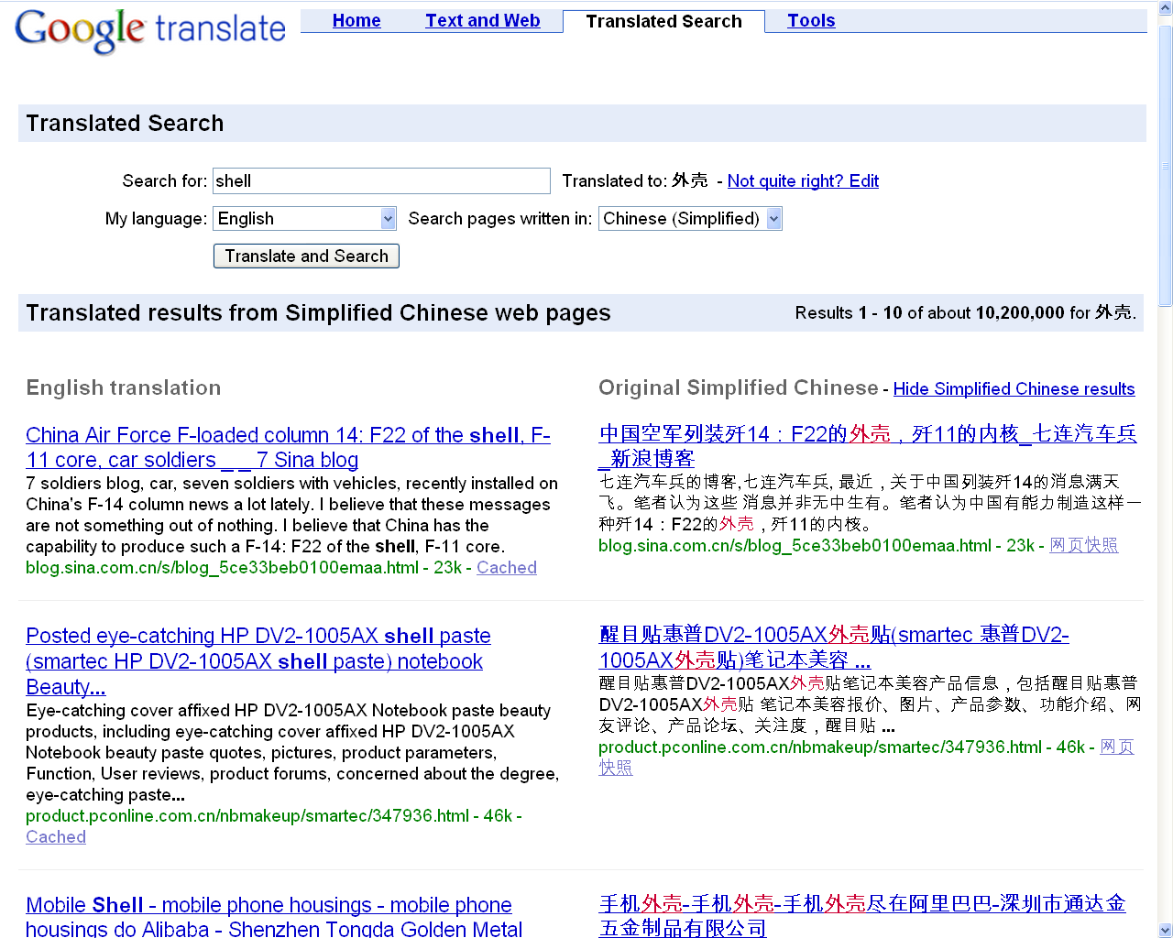
But CLIR is different

Slide 6
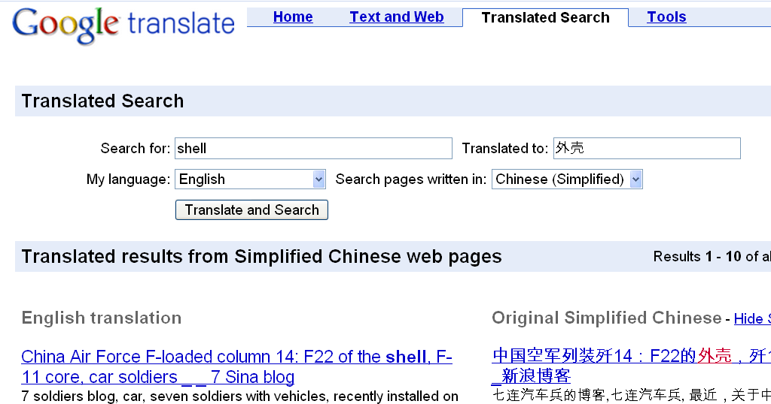
Help!

Slide 7
iCLEF methodology: hypothesis-driven
hypothesis
Reference & contrastive systems, topics, users
latin-square pairing between system/topic/user
Features:
  Hypothesis-based (vs. operational)
  Controlled (vs. ecological)
  Deductive (vs. inductive)
  Sound

Slide 8
iCLEF 2001-2005: tasks
On newswire
Cross-Language Document Selection
Cross-Language query formulation and refinement
Cross-Language Question Answering
On image archives
Cross-Language Image search.

Slide 9
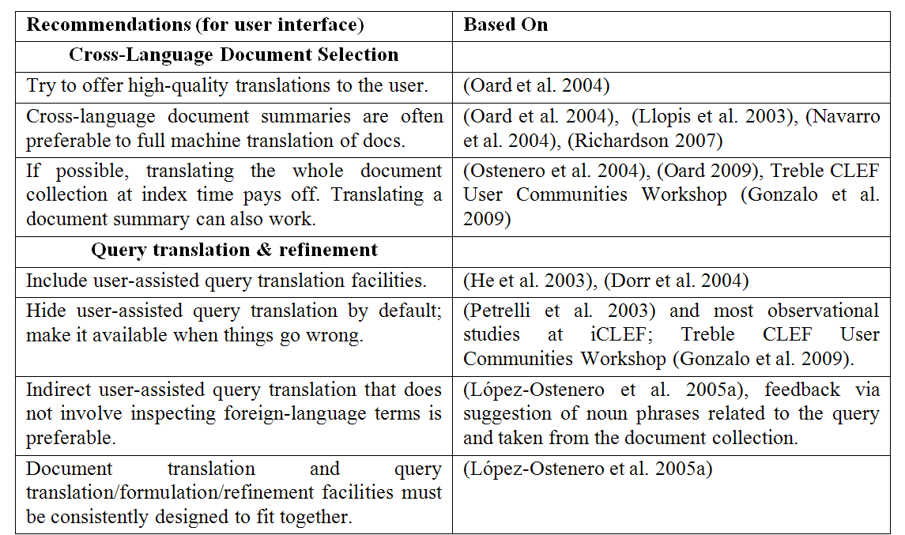
Practical outcome!

Slide 10
iCLEF 2001-2005: problems
Unrealistic search scenario, user sample opportunistic
Experimental design not cost-effective
  Only one aspect of CLIR at a time
  High cost of recruiting, training, observing users.

Slide 11
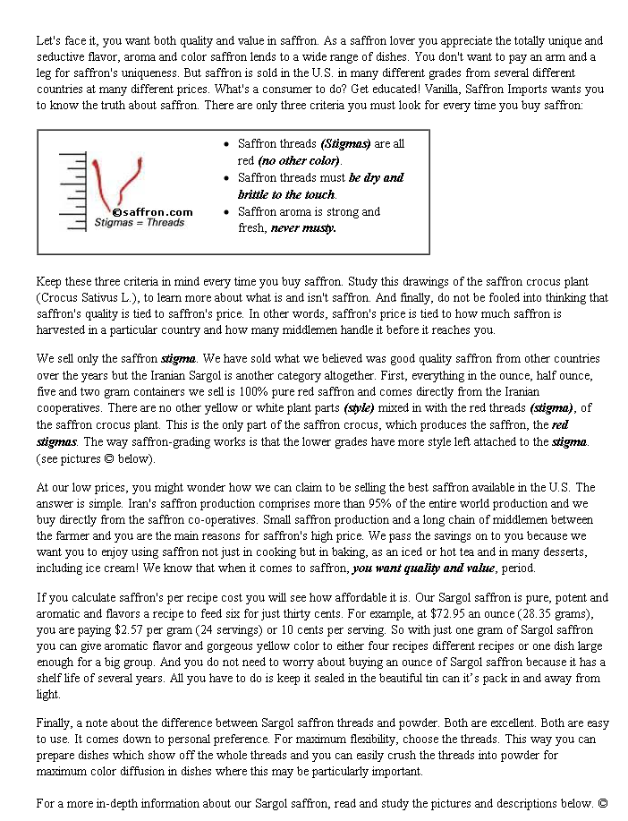
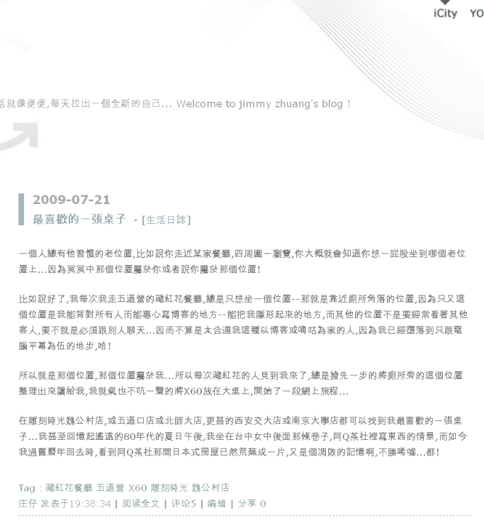
Pick a document for “saffron”

Slide 12


Pick an illustration for “saffron”

Slide 13
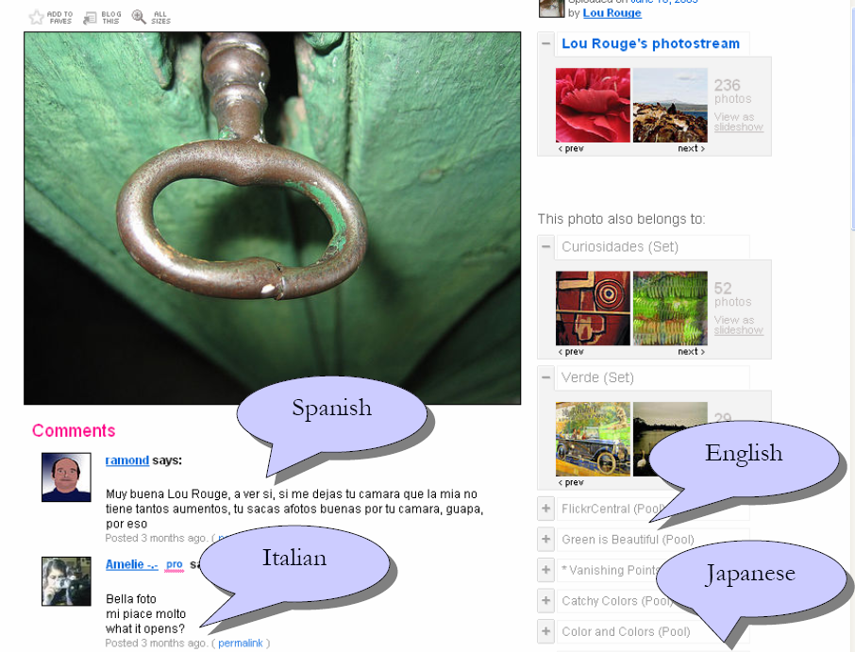
Flickr
Notes:
13

Slide 14
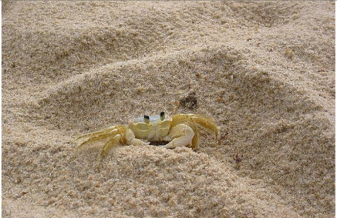
iCLEF 2006
Topics
Methodology
  Ad hoc: find as many photographs of (different) european parliaments as possible.
  Creative: find five illustrations for this article about saffron in Italy.
  Visual: What is the name of the beach where this crab is lying on?
  Participants must propose their own methodology and experiment design
Notes:
14

Slide 15
Explored issues
user’s behaviour
How users deal with native/passive/unknown languages?
Do they actually use CLIR facilities when available?
user’s perceptions
Satisfaction (all tasks)
Completeness (creative,ad-hoc)
Quality (creative)
search effectiveness
How many facets were retrieved (creative, ad-hoc)
Was the image found? (visual)
Notes:
15

Slide 16
iCLEF 2008/2009
Produce reusable dataset
search log analysis task.
Much larger set of users
online game

Slide 17
iCLEF 2008/2009: Log Analysis
Online game: see this image? Find it! (in any of six languages)
Game interface features ML search assistance
Users register with a language profile
Dataset: rich search log
All search interactions
Explicit success/failure
Post-search questionnaires
Queries
Easy to find with the appropriate tags (→ typically 3 tags)
Hint mechanism (first target language, then tags)

Slide 18
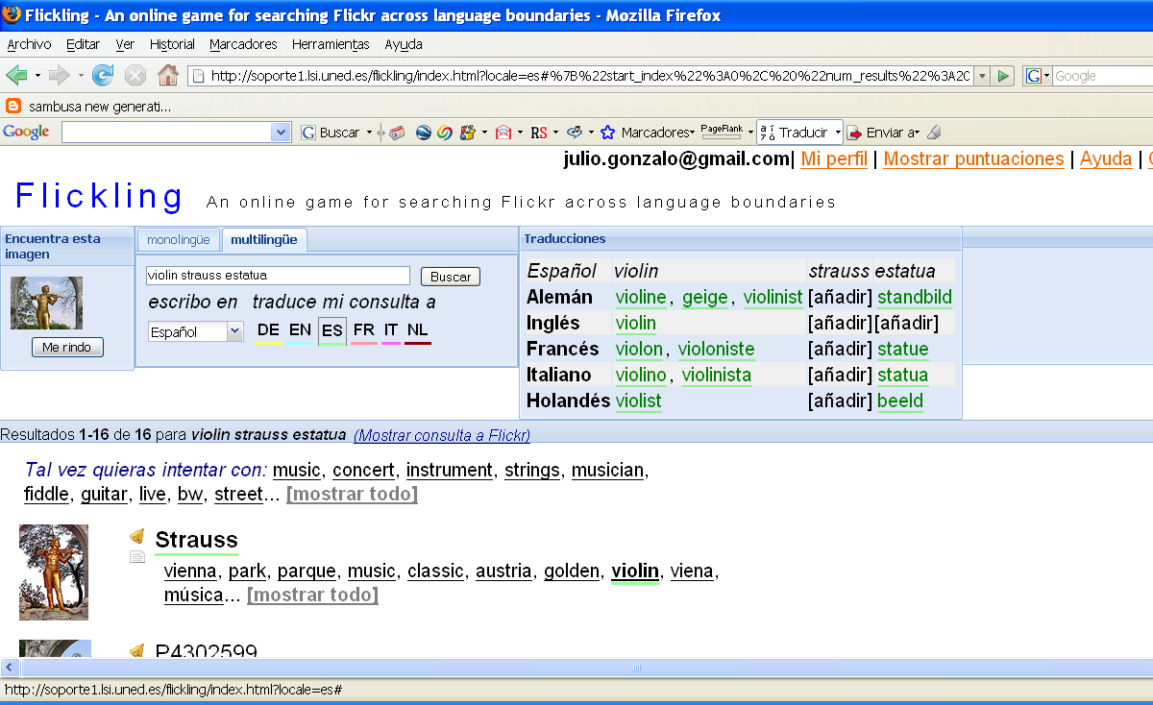
Simultaneous search in six languages

Slide 19
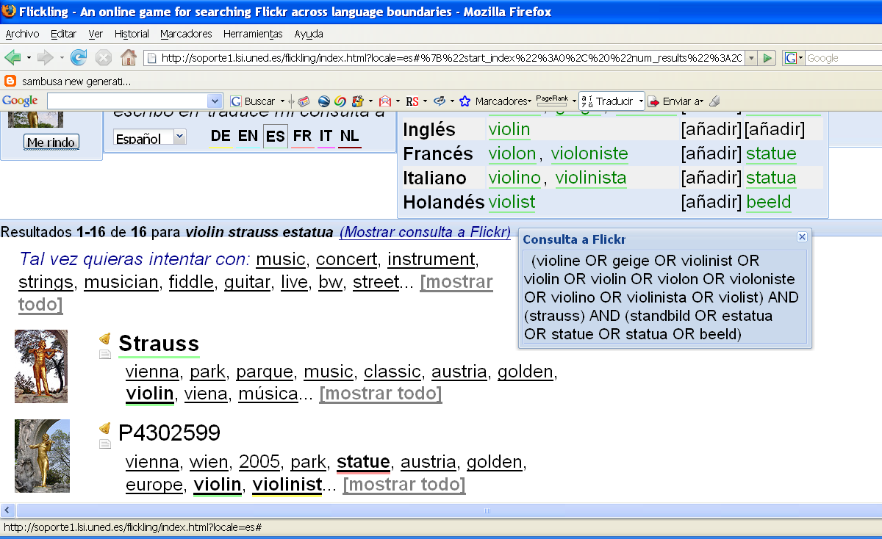
Boolean search with translations

Slide 20
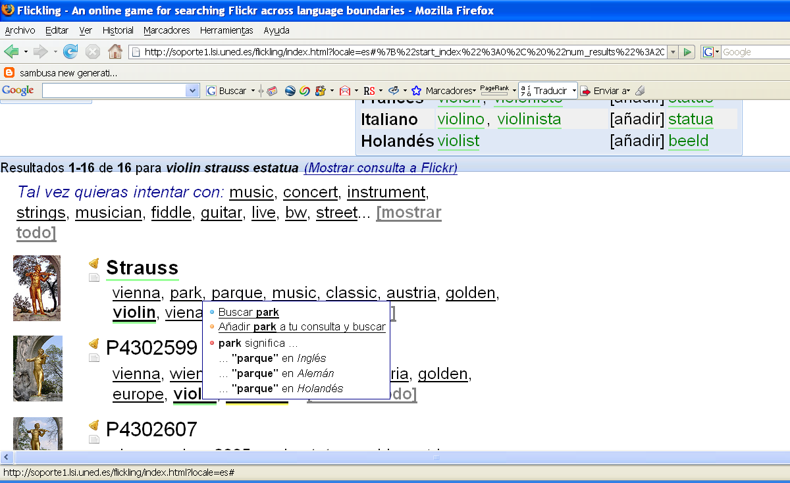
Relevance feedback

Slide 21
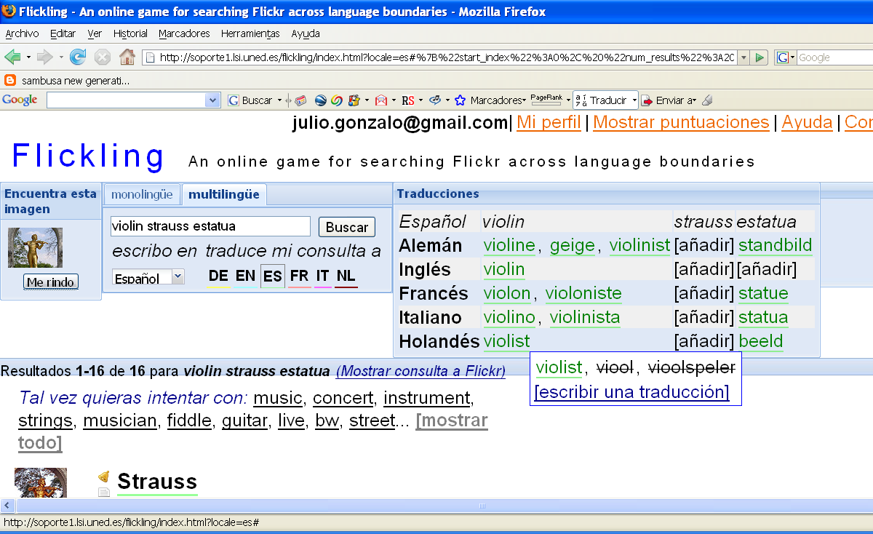
Assisted query translation

Slide 22
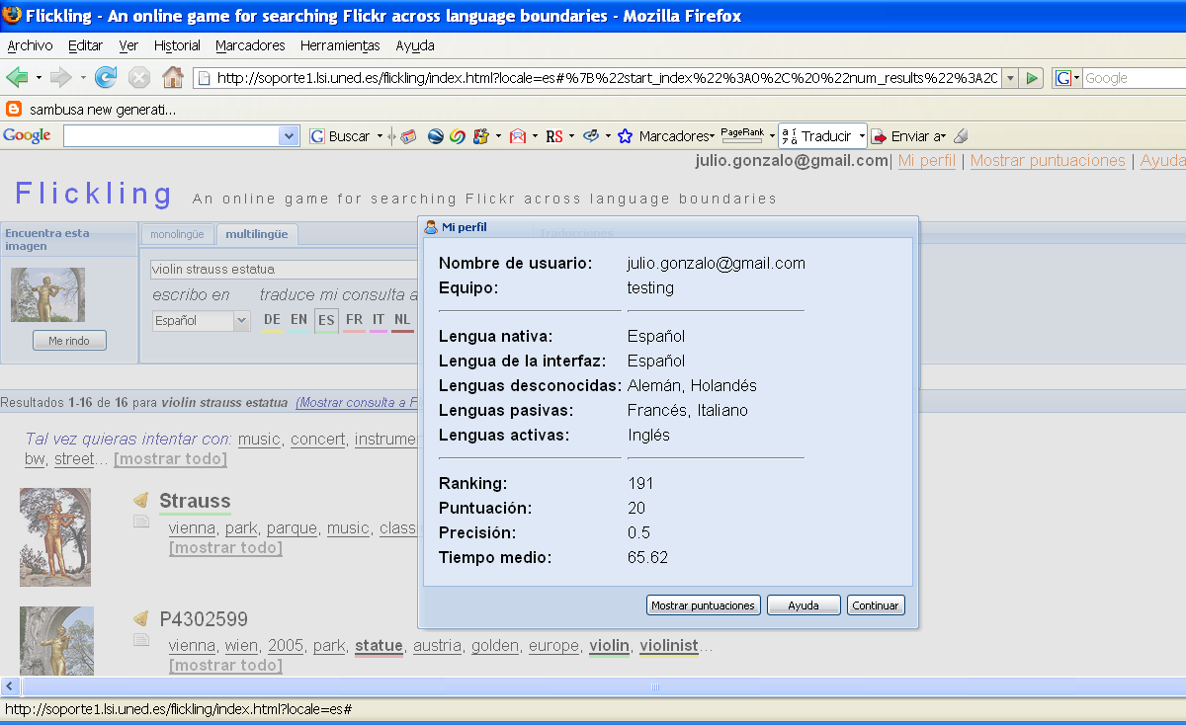
User profiles

Slide 23
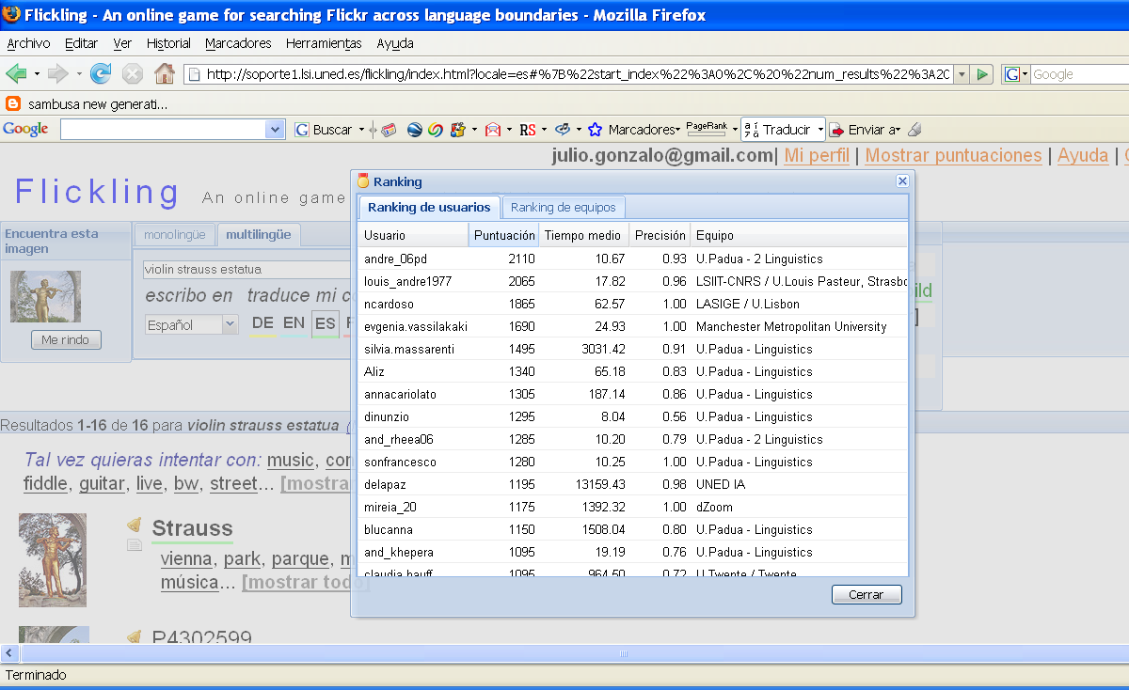
User rank (Hall of Fame)

Slide 24
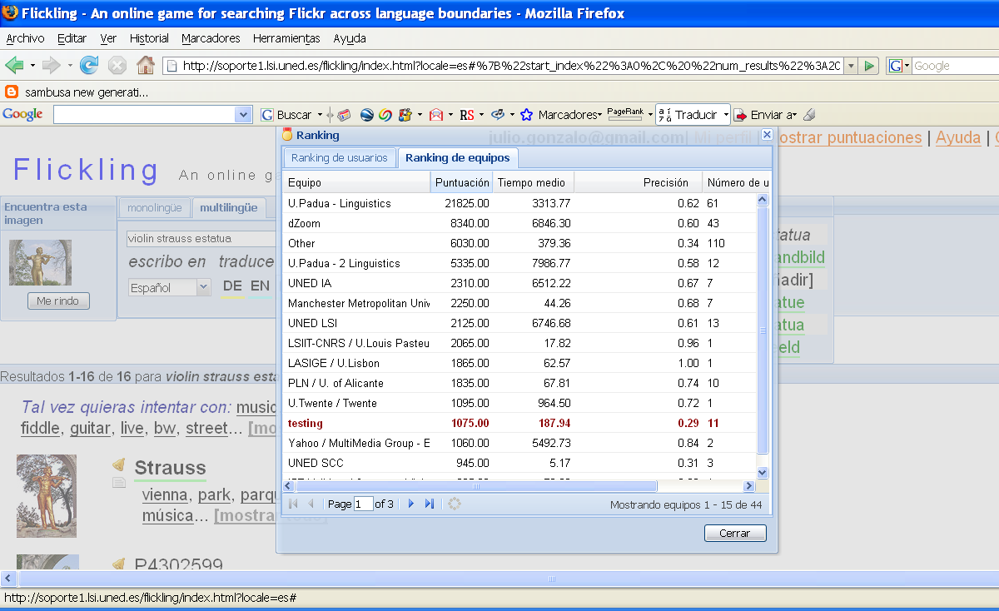
Group rank

Slide 25
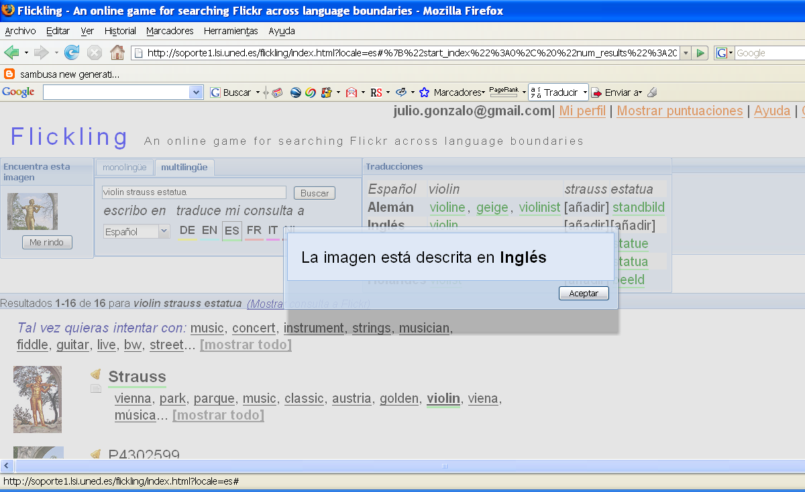
Hint mechanism

Slide 26
Language skills bias in 2008

Slide 27
Language skills bias in 2008

Slide 28
Selection of topics (images)
No English annotations (new for 2009)
Not buried in search results
Visual cues
No named entities

Slide 29
Harvested logs
2008
2009
312 users / 41 teams
5101 complete search sessions
Linguistics students, photography fans, IR researchers from industry and academia, monitored groups, other
130 users / 18 teams
2410 complete search sessions
CS & linguistics students, photography fans, IR researchers from industry and academia, monitored groups, other.

Slide 30
Language skills bias in 2009

Slide 31
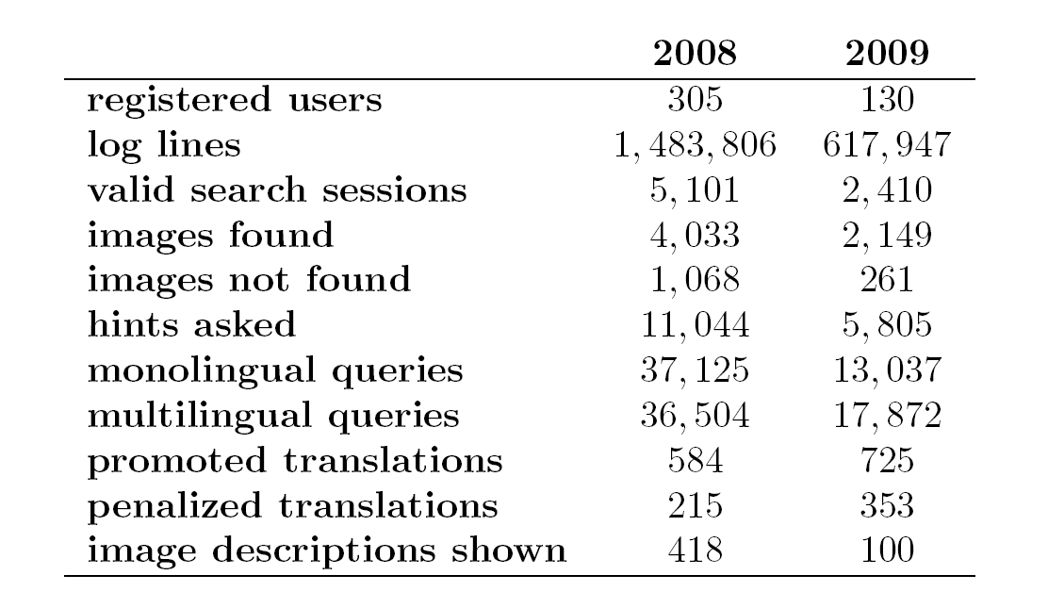
Log statistics

Slide 32
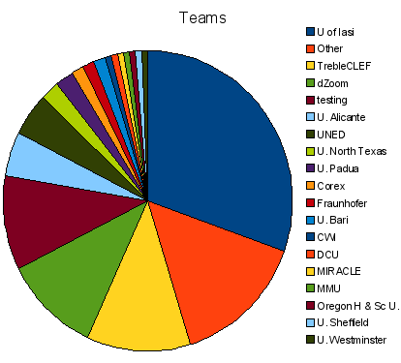
Distribution of users

Slide 33
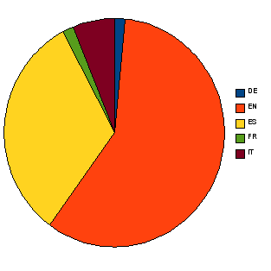
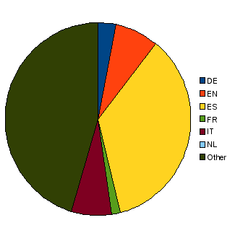
Language skills
Interface
Native languages

Slide 34
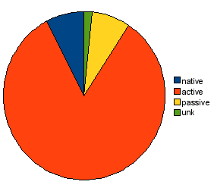
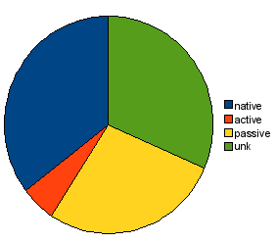
Language skills (II)
English
Spanish

Slide 35
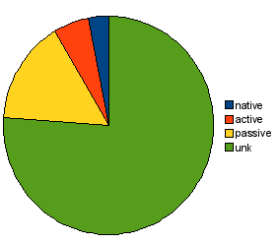
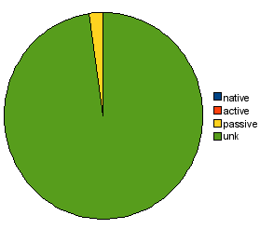
Language skills (III)
German
Dutch

Slide 36
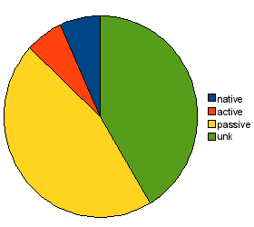
Language skills (and IV)
French
Italian

Slide 37
Participants (I): log analysis
University of Alicante
Goal: correlation between lexical ambiguity in queries and search success
Methodology: analysis of full search log
UAIC
Goal: correlations between several search parameters and search success
Methodology: own set of users, search log analysis
UNED
Goal: correlation between search strategies and search success
Methodology: analysis of full search log
SICS
Goal: study confidence and satisfaction from search logs
Methodology: analysis of full search log

Slide 38
Participants (II): other strategies
Manchester Metropolitan University
Goal: focus on users’ trust and confidence to reveal their perceptions of the task.
Methodology: Own set of users, own set of queries, training, observational study, retrospective thinking aloud, questionnaires.
University of North Texas
Goal: understanding challenges when searching images that have multilingual annotations.
Methodology: Own set of users, training, questionnaires, interviews, observational analysis.

Slide 39
Discussion
2008+2009 logs = “iCLEF legacy”
  442 users w. heterogeneous language skills
  7511 search sessions w. questionnaires
iCLEF has been a success in terms of providing insights into interactive CLIR
… and a failure in terms of gaining adepts?

Slide 40
So long!

Slide 41

And now… the iCLEF Bender Awards

Slide 42
Analysis of Multilingual Image Search Sessions
Víctor Peinado, Fernando López-Ostenero, Julio Gonzalo
UNED @ iCLEF2009

Slide 43
Search Log Analysis
98 users with ≥ 15 sessions
≥ 1M log lines have been processed (2008 + 2009)
5,243 search sessions w. questionnaires
analysis of sessions comparing:
  Active / passive / unknown language profiles
  Successful / unsuccessful

Slide 44
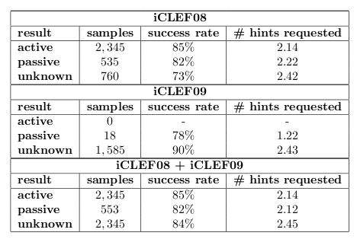
Success vs. Language Skills

Slide 45
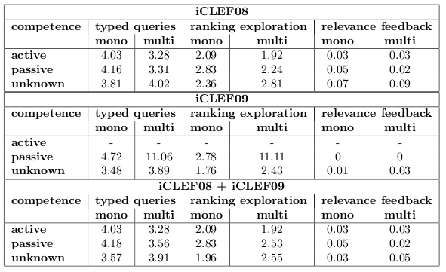
Cognitive Effort vs. Language Skills

Slide 46
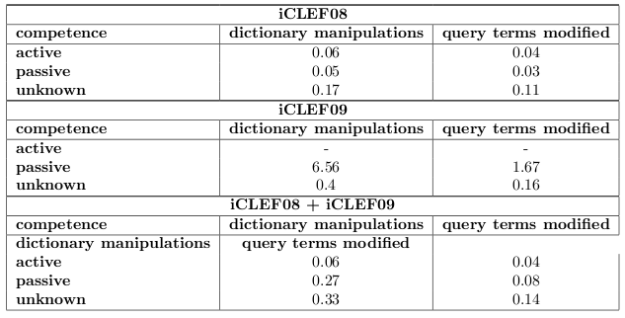
Use of CL Facilities vs. Language Skills

Slide 47
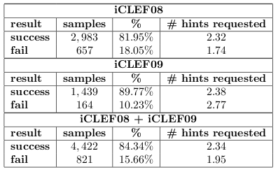
Success / Failure

Slide 48
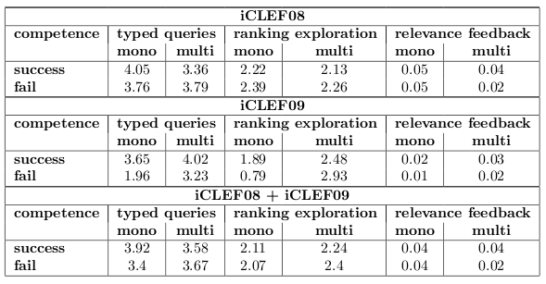
Cognitive Effort vs. Success

Slide 49
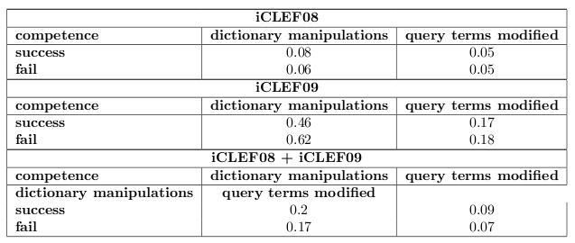
Use of CL facilities vs. success

Slide 50
Questionnaires
Selecting/finding appropriate translations for the query terms is the most challenging aspect of the task
In iCLEF09 80% of the users agree with the usefulness of the personal dictionary vs 59% who preferred the additional query terms suggested by the system
78% of iCLEF08 users missed results organized in tabs, 80% of iCLEF09 users complained about bilingual dictionaries
iCLEF08 users claimed to have used their knowledge of target languages (90%), while iCLEF09 users opted for using additional dictionaries and other on-line sources (82%)

Slide 51
Discussion
Easy task? (≥ 80% success for all profiles)
Direct relation between use of CL facilities and lack of target language skills
Positive correlation between use of relevance feedback and success
CL facilities highly appreciated in a multilingual search scenario

Slide 52
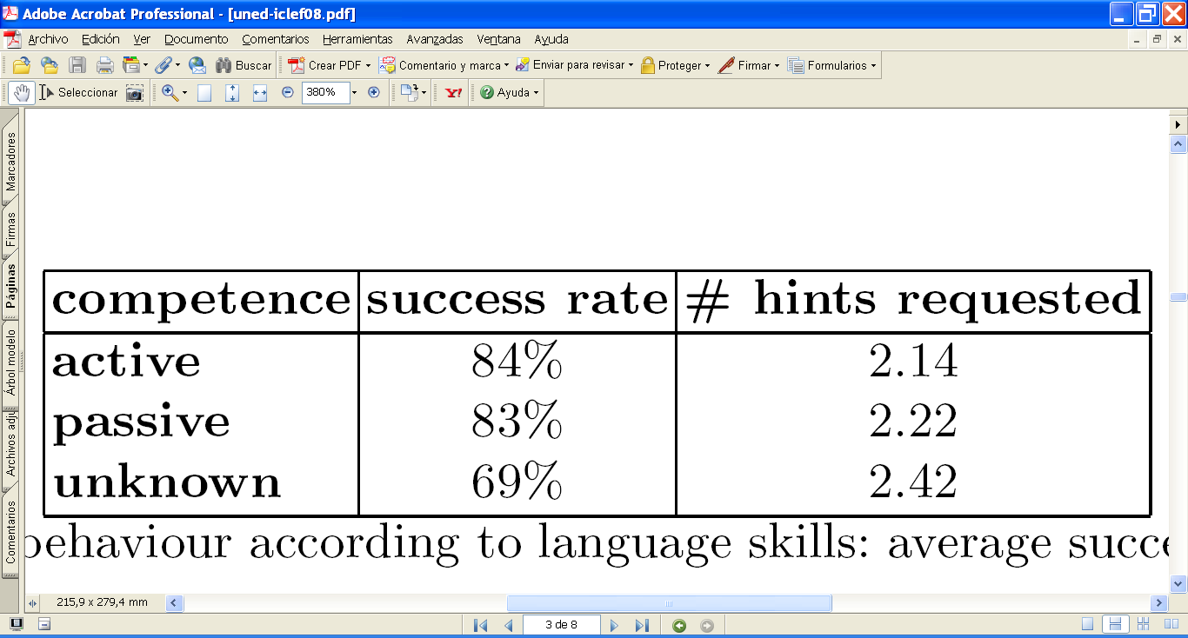
Success rate and language profiles

Slide 53
Success rate vs. number of hints

Slide 54
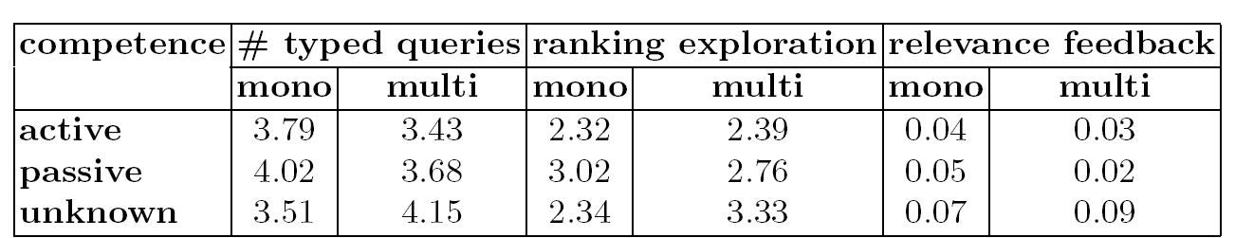
Cognitive cost and language profiles

Slide 55
Search modes and language profiles
Una vez que se conoce el idioma destino:
Modo multilingüe:
pasivos → 23% + que activos
Desconocidos → 61% + que activos
Modo monolingüe:
pasivos → 4% - que activos (!!!)
Desconocidos → 23% - que activos (!!!)

Slide 56
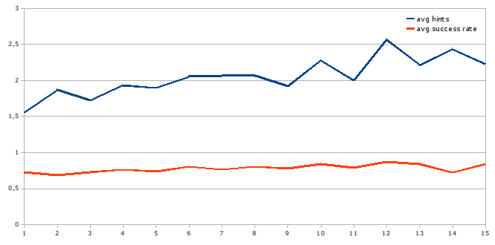
Learning effects: success and #hints
Notes:
56

Slide 57
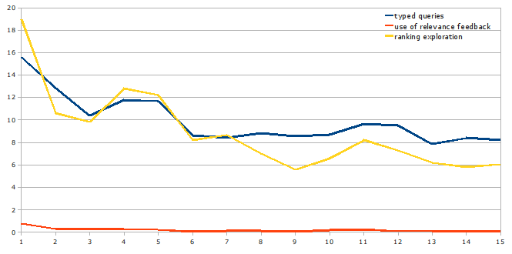
Learning effects: cognitive cost

Slide 58
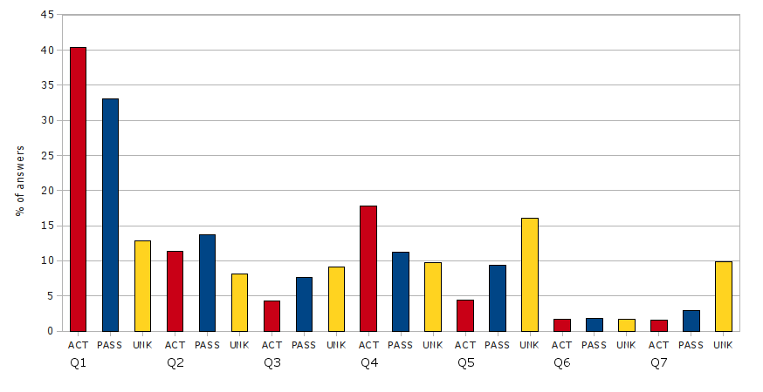
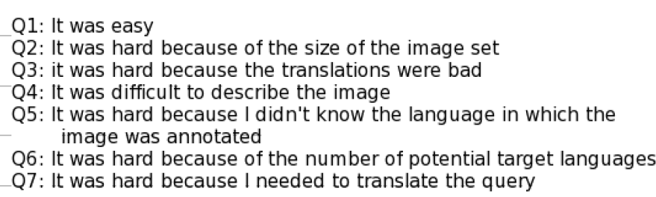
Questionnaires after success
Highest difficulty is cross-linguality for the “unknown” group.

Slide 59
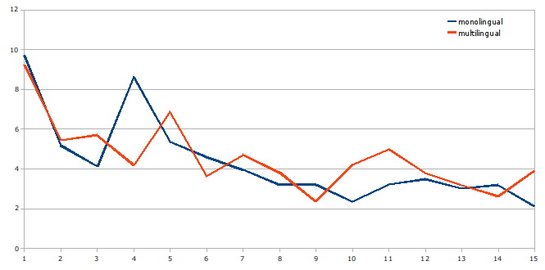
Aprendizaje: exploración ranking

Slide 60
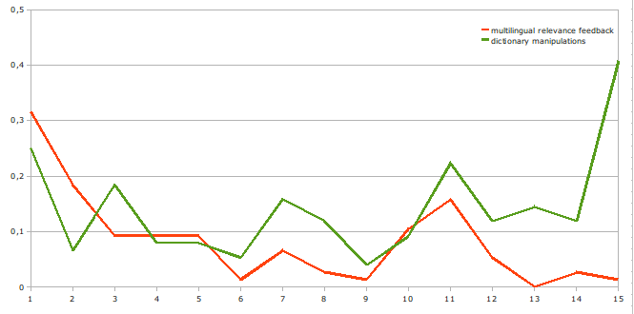
Assisted query translation vs. Relevance feedback
Notes:
60

Slide 61
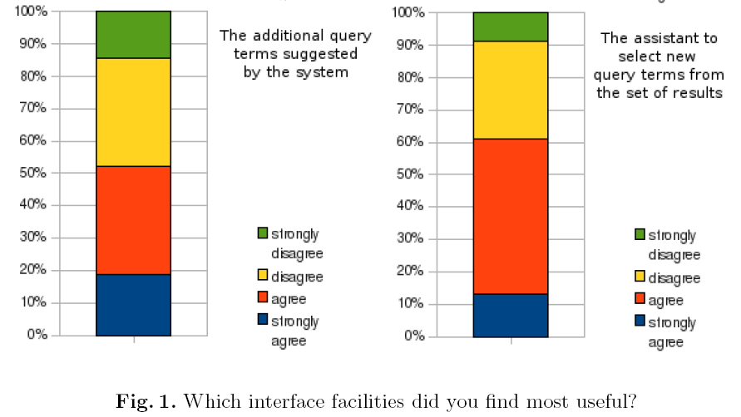
Perceived utility(I)

Slide 62
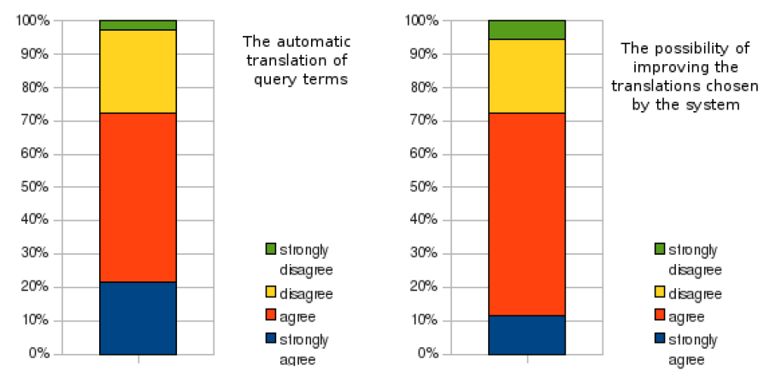
Perceived utility(II)

Slide 63
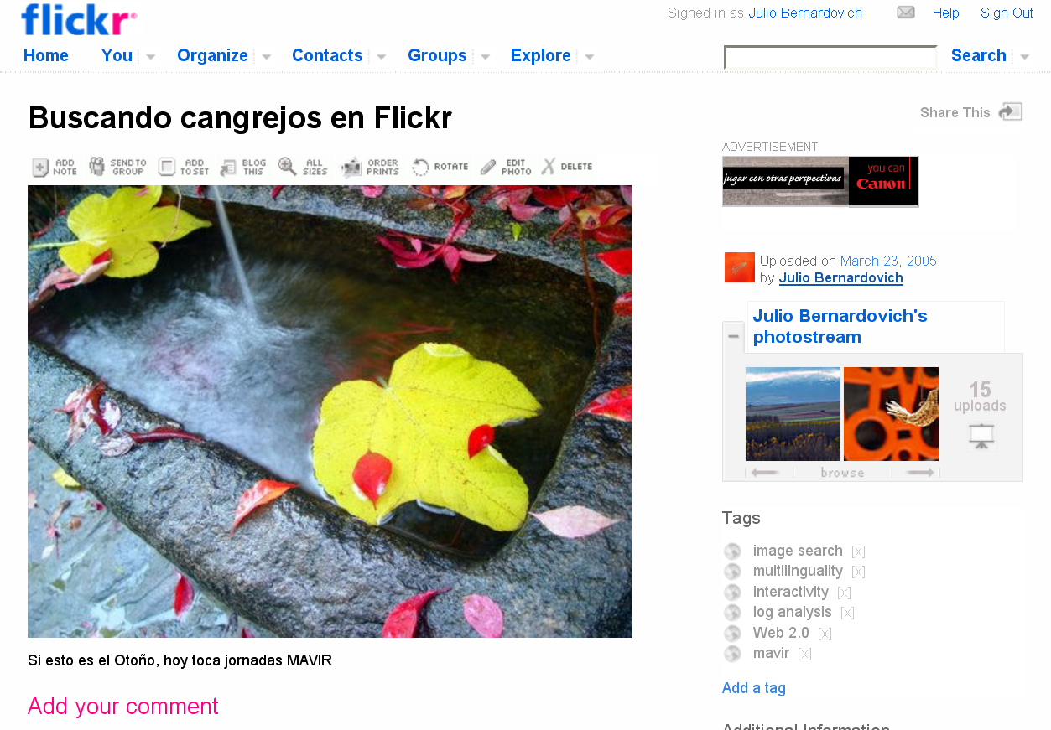
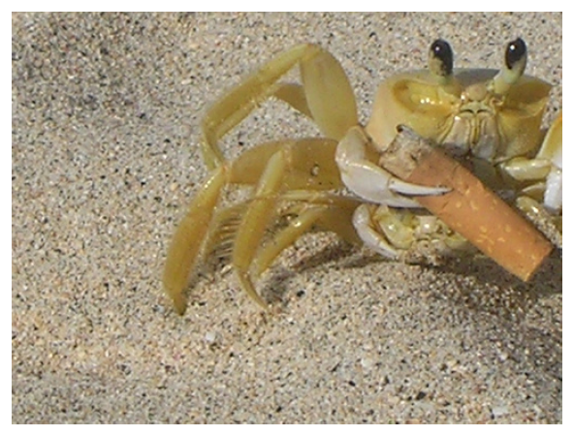

Notes:
63

