Slide 1


Addressing the Medical Image Annotation Task using visual words representation
Uri Avni , Tel Aviv University, Israel
Hayit Greenspan Tel Aviv University, Israel
Jacob Goldberger Bar Ilan University, Israel
Notes:
Uri Avni from TAU
Hayit Greenspan TAU, and Jacob Goldgerger from BIU
We participated in the medical image annotation task

Slide 2
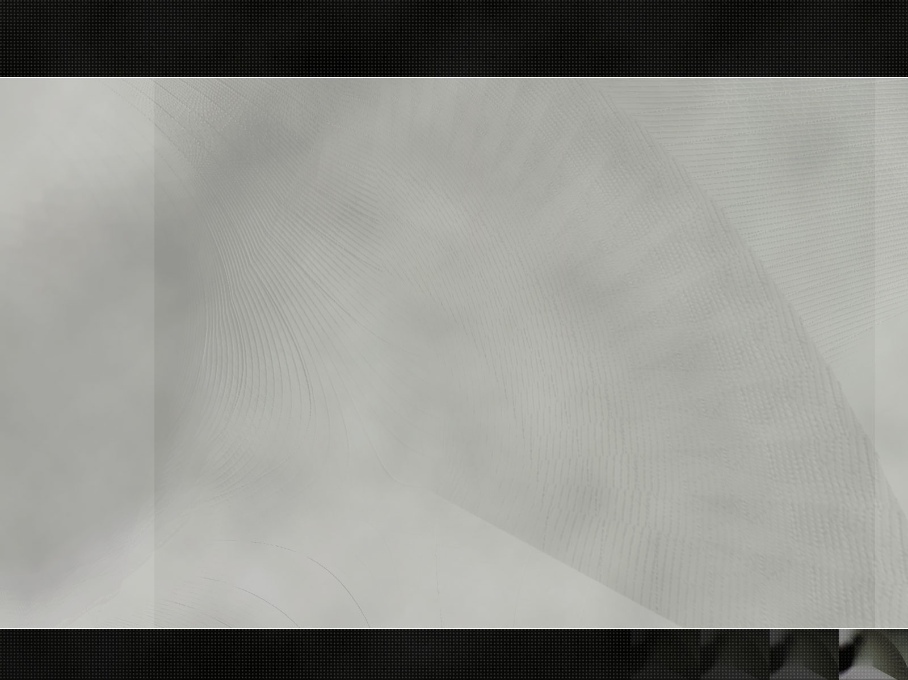
Outline
Challenge description
Proposed system
  Image representation
  classification
Results
  Parameters optimization
  Performance analysis
Conclusion
Notes:
Describe quickly the task, our system, and the results

Slide 3
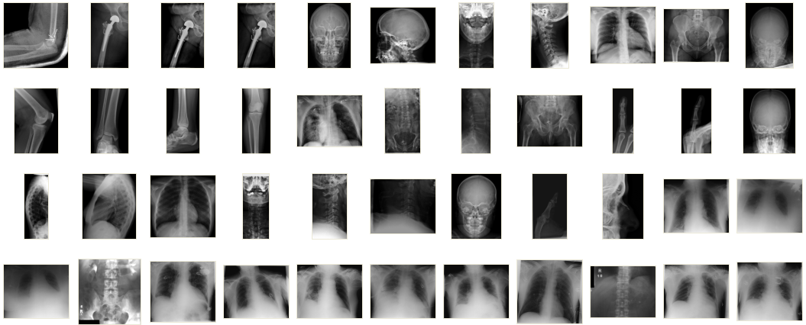
ImageClef 2009 medical annotation challenge
12,677 classified x-ray images, 1733 unknown images
Classification according to four labeling sets:
57 classes
116 classes
116 IRMA codes
196 IRMA codes
Notes:
Task this year was a recap of the previous four years
12 thousand images, 17 hundred unknown images
Images labeled according to four labeling sets, with increasing complexity (57 classes used in 2005) to 196 irma codes last year

Slide 4

























IRMA database
Noisy images
Irregular brightness, contrast
Non-uniform class distribution
The IRMA group - Aachen University of Technology (RWTH), Germany
Notes:
IRMA database consists of scanned x-ray images,
These are Grayscale 512 pixels long, images are noisy – irregular brightness and contrast
Class dist. Not balanced - some classes with over 1000 samples, some with just a few, 10 or less

Slide 5
IRMA Database - samples
Great intra-class variability
Category #: 1121-230-961-700 Sagittal, Mediolateral, Left hip
Notes:
Some classes has great variability within the class, for eg this class is of the left hip joint in a certain direction,
You can see it has irregular orientation, artifacts such as artifical limbs,
x-ray border.
If you look at gradients – these artifacts are stronger than the actual content.

Slide 6
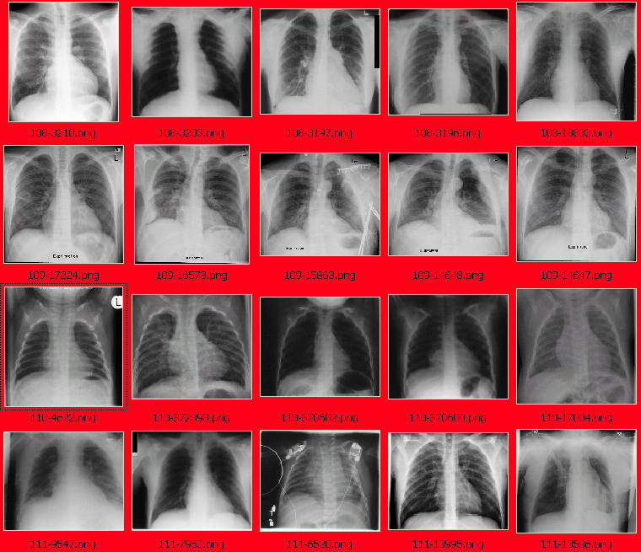
IRMA Database - samples
Category #1121-110-500-000
overview image
posteroanterior (PA)
Category #1123-112-500-000
high beam energy
posteroanterior (PA),expiration
Category #1123-121-500-000
high beam energy
anteroposterior (AP),inspiration
Category #1121-127-500-000
overview image
anteroposterior (AP), supine
Great inter-class similarity
Notes:
On the other hand – different classes may have high similarity
Every row – from different class .
The difference is xray beam direction , and patient is breathing out or in
It is a challenge for humans to distinguish between these categories, if you are not a trained physician, let alone to machine

Slide 7
Outline
Challenge description
Proposed system
  Image representation
  classification
Results
  Parameters optimization
  Performance analysis
Conclusion

Slide 8
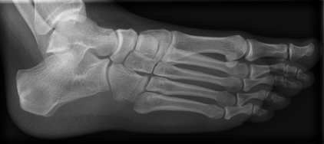
Image representation
Move from 2D image to a vector of numbers
Representation should preserve enough information of the image content
Should be not sensitive to translation, artifacts and noise
Compare and classify the compact representation
Image model
0.04
0.02
0
0
100
200
Word number
Notes:
I will start by saying that the system is straight forward, although it’s simple, it demonstrated rather strong results, and it’s efficient.
Goal of the image representation step is to move from a 2d image to a vector of numbers
Should preserve information of the image content enough to classify it correctly
At the same time not be sensitive to object placement, artifacts, image quality

Slide 9

Patch extraction
Extract raw pixels from patches of fixed size
Dense sampling, ~200,000 patches per image
Normalize intensity, variance
Ignore empty patches
Sample several images – one collection with millions of patches
Notes:
10/1/09
9
To do that we use a collection of local features – or the bag-of-visual words technique, popular general image classification tasks
Rectangular patches , dense sampling . Take a patch around every pixel, with overlap between neighboring patches (200,000 patches for a single image)
normalize patch mean intensity – and normalize variance. gives invariance to local diff. in contrast and bright.
Xray images has a lot of empty patches, treat like stop words in text doc, ignored. We repeat the process of patch extraction on random images, without considering their class, to create one large mix of several M patches

Slide 10
Feature space description
- Reduce dimension of the collection
Add position (x,y) to the features, position weight is important
8 dimensional feature vector
9x9 pixels
PCA
6 coefficients
Notes:
10/1/09
10
Next step is to simplify this large collection of data.
Patch of size 9 by 9 pixels - or 81 values, would be reduced using PCA to 6 coefficients. 6 components with most energy shown (eigenvectors). Patch is a linear combination of these.
These are content features, patch location is lost – an edge at the top is different than edge at the bottom.
important step in feature selection is to add the patch center (x,y coordinates) to the feature list.

Slide 11
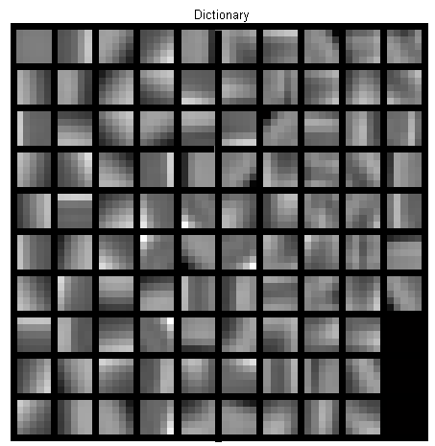
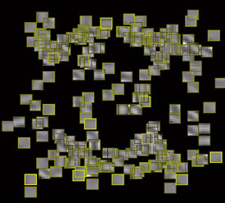
Build dictionary
Select k feature vectors as far apart as possible
Run k-means clustering
Cluster centers
Cluster centers , with x,y
Notes:
10/1/09
11
Run k-means to find dominant clusters in the feature space
Here – simplified dictionary of 100 words looks like.
Left – visual words without position in feature vector –
Words are primitive image parts, edges in different directions, corners,
On the right - when using x,y in the feature space. words are spread across the image –
Unlike building several dictionaries for different image regions, this technique has no boundary problem between regions

Slide 12
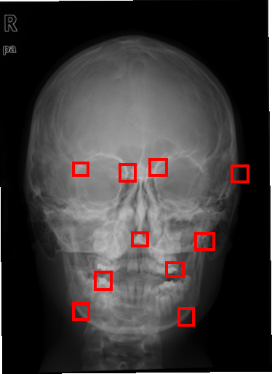
Image representation
Scan image – translate patches to words histogram
Dictionary
Image
Probability
0.04
0.02
0
0
50
100
Word number
Notes:
10/1/09
12
Translation from image to a vector of number is straight forward, scan all pixels, sample local patch,
Convert to feature space, find closest word, add to histogram the index of the word

Slide 13
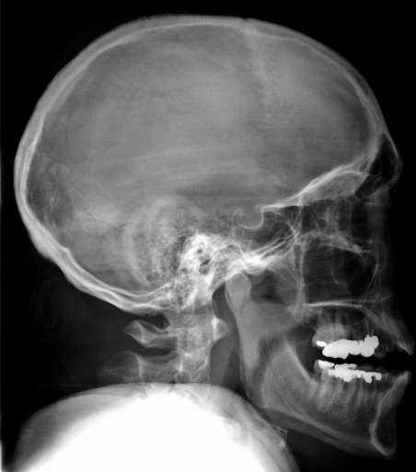

Image representation
Use multiple scales
0
0
50
100
150
200
250
300
Notes:
10/1/09
13
In this task objects are about the same size, no need for scale invariance,
It may be helpful to look at several image scales, discriminative information may be better captured in some scales, or in a combination of scales.
Repeat the whole process, with multiple image scales, where patch size stays fixed.
, dictionary for each scale, Chaining of several histogram of individual scales. No need mix scales.

Slide 14
Classification
Examine knn classifier, with different distance metrics
  One-vs-one multiclass SVM classifier, with n(n-1)/2 binary classifiers
  Examine several SVM kernels:
    Radial basis function
    Chi-square
    Histogram intersection
Notes:
For classification we examined a k-nn classifier, with several distance metrics
and a multiclass one-vs-one svm classifier, for all pairs of classes
For the svm classifier we examined several kernels, rbf, chi-square and histogram intersection.
One apealing feature about histogram intersection kernel, apart from being a natural way to compare histograms, is that it has no free parameters – optimizing a classifier with it is easy.
(alternately could use Pyramid Match Kernel)

Slide 15
Outline
Our objective
Proposed system
  Image representation
  Retrieval & classification
Results
  Parameters optimization
  Performance analysis
Conclusion and future work
Notes:
Ill go over the classification results, sensitivity to different parameters , and performance analysis

Slide 16
Selecting classifier type
Effect of histogram distance metric in k-nearest neighbors vs svm classifier
SVM
Symmetric Kullback – Leibler divergence
Jeffery divergence
Notes:
The four columns on the left shows classification accuracy (%) of the k-nearest neighbor classifier,
For several distance metrics, some information theoretic measures s.a. SKL , JD,
The right bar shows the classification of the SVM classifier with non-linear kernel, it is far superior, over 5% improvement

Slide 17
Selecting feature space
Effect of parameters on classification accuracy, using 20 cross-validation experiments
with x,y
No x,y
Notes:
Importance of feature selection –
Random cross validations with 2000 test , (run 20 times) bar length show standard deviation
On the right – number of PCA components as little effect, from 6 to 10 components the accuracy is about the same.
On the other hand, adding X,Y to the feature list has a dramatic affect , from 87% without x,y to average of 91% with x,y.

Slide 18
Selecting features
Selecting type of features - invariance / discriminative power tradeoff
Feature type | Average % correct | Standard dev
Raw patches | 88.43 | 0.32
SIFT* | 90.80 | 0.41
Normalized Patches | 91.29 | 0.56
* Scale and rotation invariance are not desired
Notes:
In this task scale invariance is not desired, xray images objects appear in about the same size
Rotation invariance of individual patches is not necessary.
We did however examined popular SIFT descriptors, 128 values long local edge histograms, at a single scale absolute rotation. reduced with pca to be in manageable size.
Table: Raw patches – raw gray levels, PCA , 88.4% SIFT – 90.8%
Normalized patches ( mean and variance) -91.29%
Simpler to calculate, gives about the same accuracy, slightly higher

Slide 19
Running time
12,677 images
Running on Intel daul quad core Xeon 2.33Ghz
 | Build dictionary | Extract features | Train classifier | classification time per image | Total (train + classify)
Raw | 6 min | 96.8 min | 6 min | 0.54 sec | 126 min
SIFT | 10 min | 597 min | 6 min | 3.32 sec | 724 min
Notes:
When it comes to computation times, the picture is different
Running time is divided to four steps – dictionary building, feature extraction step – bulk of the time, classifier training, and classification.
Overall running time, test+train, from a collection of png files to full annotation 2 hours with raw patches, 6 hours using SIFT descriptors.
the classification time of new image, without preprocessing is1/2 a sec with raw patches, 3.3 sec with SIFT
using SIFT descriptors are not the optimal choice in this task.

Slide 20
Selecting dictionary
Notes:
Because words has x,y coordinates – we need enough words to capture differences in all image regions. We would expect the need of a large dictionary. Increasing dictionary size, upto about 1000 words improves the performace,
Beyond that there is no apparent improvement, there is an impact on the compotation time.

Slide 21
Selecting dictionary
Using multiple dictionaries for 3 scales increases classification accuracy by 0.5%
Notes:
Using multiple image scales – improves the performance slightly, .5% (10 images of the test set)
not dramatic, gives a slight edge

Slide 22
Classification results – effect of kernel
Effect of kernel function on SVM classifier, for optimal kernel parameters
Kernel Type | % Correct 1 Scale 3 Scales
Radial Basis | 91.45 | 91.59
Histogram Intersection | 91.29 | 91.89
Chi Square | 91.62 | 91.95
Notes:
SVM Kernel – when using optimal values, both of kernel parameter and SVM cost parameter –C , there is little difference, all show average accuracy between 91% to 92%
Chi Square is slightly better, just short of 92%

Slide 23
Classification results – confusion matrix
Confusion matrix of random 2000 test images (2007 labels)
91.95% correct
Notes:
Confusion matrix of the best system, in logarithmic scale , 116 categories of the 2007 label set.
92% on the diagonal
For the actual test images of the task – ~85% of the labels were classified correctly, was harder than a random subset of the training data.

Slide 24
Submission to ImageClef 2009 medical annotation task
One run submitted
Use the same classifier for the 4 label sets (2005,2006,2007,2008)
Ignore IRMA code hierarchy
Don’t use wildcards
Run & error score | 2005 | 2006 | 2007 | 2008 | SUM
TAUbiomed | 356 | 263 | 64.3 | 169.5 | 852.8
Notes:
This year we submitted one run for the medical annotation challenge,
Used the same classifier for all four labeling sets, without changing parameters as the complexity increases
ignored the irma code hierarchy – treat every code as different category.
Don’t use wildcards – classify all the way
Our score ranked first among the few participants, a place higher than last yr
Maybe using the code structure and optimizing per labeling set could further improve the accuracy, we’ll never know because unfortunately the task ends.

Slide 25
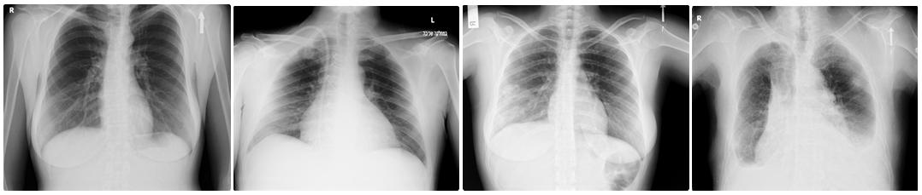
Conclusion & future work
Using visual words with simple features and dense sampling is efficient and accurate in general x-ray annotation
We are applying the system to pathology classifications of chest x-rays, together with Sheba Medical Center
Healthy Enlarged heart Lung filtrate Left+right effusion
Notes:
We saw that using a straight forward visual words classifier with dense sampling is both accurate and efficient in general x-ray annotation task
Future work,
In these days we are collecting together with Sheba Medical Center in Israel a collection of diagnosed chest x-ray images, and applying the system to classify pathologies.
We now have ~200 images, if the database will be large enough –we can try to make it publicly available. if it’s interesting,

Slide 26
Thank you.

