Slide 1

Persian@CLEF
Current and Future Research Directions
University of Tehran
Database Research Group
Abolfazl AleAhmad, Ehsan Darrudi, Hadi Amiri, Azadeh Shakery, Farhad Oroumchian
1 October 2009

Slide 2
Persian@CLEF Current and Future Research Directions
Outline
Why Persian IR
Language Resources for Persian
Hamshahri at CLEF 2009
Persian@CLEF2009 participants
Persian@CLEF2009 results
Persian@CLEF2009 pool analysis
Future works

Slide 3
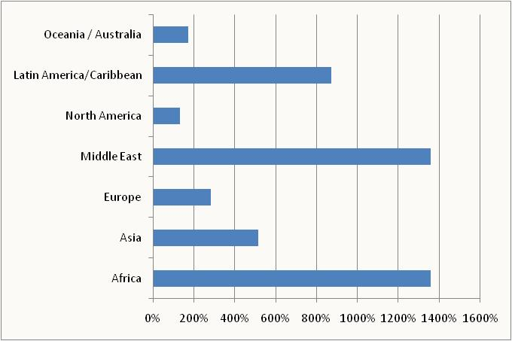
Persian in the Middle East
Persian@CLEF Current and Future Research Directions
User Population Growth on the Web (2000-2009)
Source: Internet World Stats, http://internetworldstats.com/

Slide 4
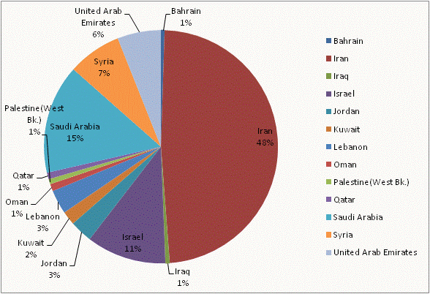
Persian@CLEF Current and Future Research Directions
Why Persian IR
Updated in June 2009 from Internet World Stats

Slide 5
Persian@CLEF Current and Future Research Directions
The Persian Language
A branch of Indo-European Languages
Official Language of Iran, Afghanistan and Tajikistan
Its morphological analysis is Comparably difficult
  The word “خبر” has two plural forms:
    Persian rules: “خبرها”
    Arabic rules: “اخبار”
Writing Style Issues:
  e.g. ”می شود“ and “میشود” are the same
  e.g. ”کتابها“ and ”کتاب ها“ are the same

Slide 6
Persian Test Collections
Persian@CLEF Current and Future Research Directions
Text IR Domain
  Ghavanin (domain specific)
  Hamshahri (news): http://ece.ut.ac.ir/dbrg/hamshahri
  Hamshahri 2 (recently developed 50 topics)
Web IR Domain
  FWT1m (.ir Web) nearly 1Million docs
NLP Domain
  Bijankhan (2.7 Million Words): http://ece.ut.ac.ir/dbrg/bijankhan

Slide 7

Hamshahri at CLEF 2008 & 2009
Persian@CLEF Current and Future Research Directions
News articles of Hamshahri newspaper
from year 1996 to 2002
100 bilingual topics
166,000+ documents
Hamshahri 2
News articles of Hamshahri newspaper
from year 1996 to 2008
50 bilingual topics
320,000 documents (2times larger ~ 1.5GB)
Richer document tags

Slide 8
Persian@CLEF Current and Future Research Directions
Persian@CLEF2009 - Participants
JHU-APL
  N-gram tokenization (skip n-grams for n=5)
Unine
  Developed “light” and “plural” stemmers and blind query expansion
Open Text
  Savoy’s Stemmer and 4-grams
  Pool analysis (with top 10,000 retrieved docs)
Quazvin IAU
  Perstem for monolingual runs (Prec +91%, Rec +43%)
  “Query Wikification” Algorithm for bilingual runs

Slide 9
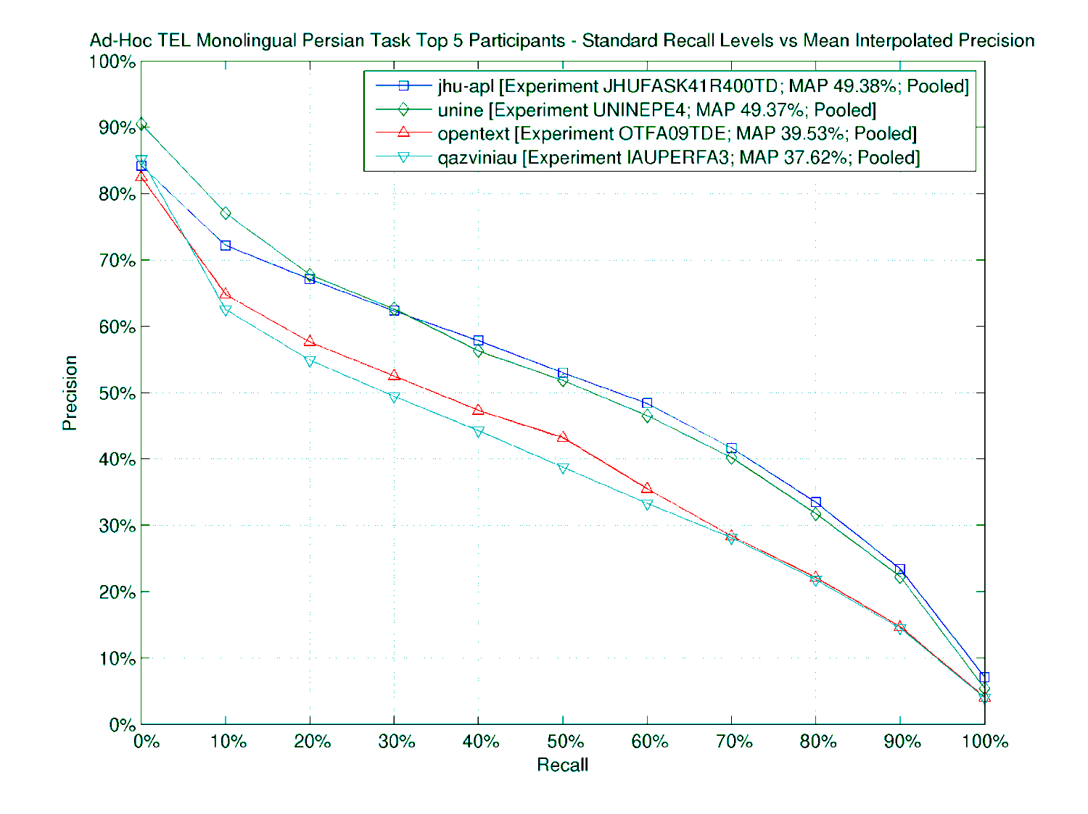
Persian@CLEF Current and Future Research Directions
Persian@CLEF2009 - Final Results

Slide 10
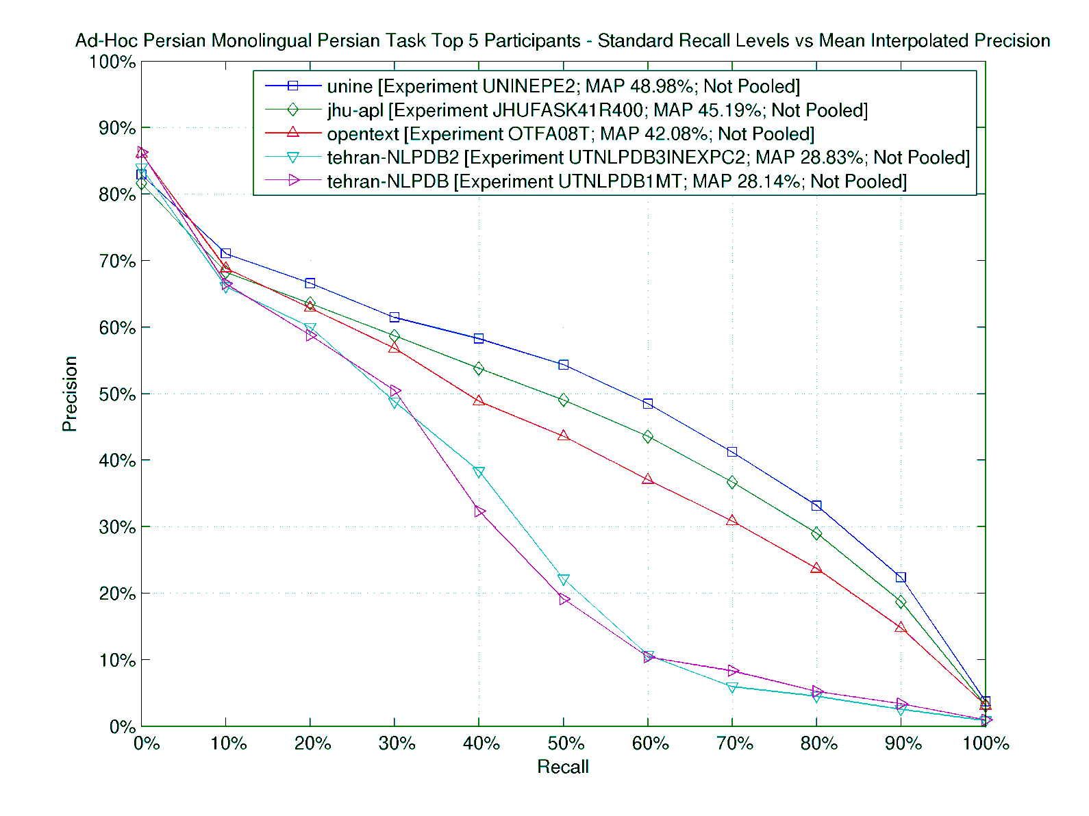
Persian@CLEF Current and Future Research Directions
Persian@CLEF2008 - Final Results

Slide 11
Persian@CLEF Current and Future Research Directions
Pool of CLEF 2008

Slide 12
Persian@CLEF Current and Future Research Directions
Pool of CLEF 2009

Slide 13
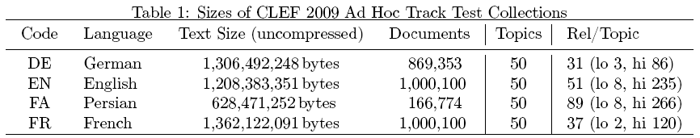
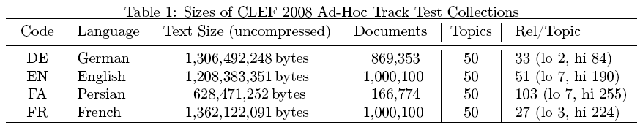
Persian@CLEF Current and Future Research Directions
Persian@CLEF- Pool Comparison
Quoted from: Stephen Tomlinson. German, French, English and Persian Retrieval Experiments at CLEF 2008 & 2009. Working Notes for the CLEF 2008 & 2009 Workshops.

Slide 14
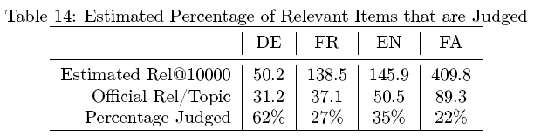
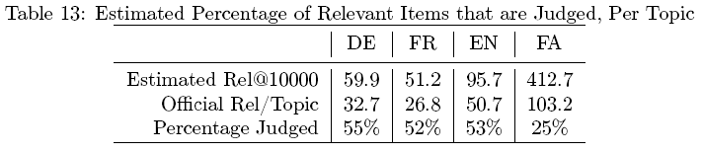
Persian@CLEF Current and Future Research Directions
Persian@CLEF- Pool Comparison
2009
2008
Quoted from: Stephen Tomlinson. German, French, English and Persian Retrieval Experiments at CLEF 2008 & 2009. Working Notes for the CLEF 2008 & 2009 Workshops.

Slide 15
Persian@CLEF Current and Future Research Directions
Future Works
Using Hamshahri 2 for CLEF 2010 (50 training topics)
A campaign on the Persian WebIR collection
Creation of an English-Persian parallel corpora
Creation of a comparable corpora
A stemmer for the Persian language
http://ece.ut.ac.ir/dbrg

Slide 16
Thanks
Persian@CLEF Current and Future Research Directions
?
a.aleahmad@ece.ut.ac.ir

Slide 17
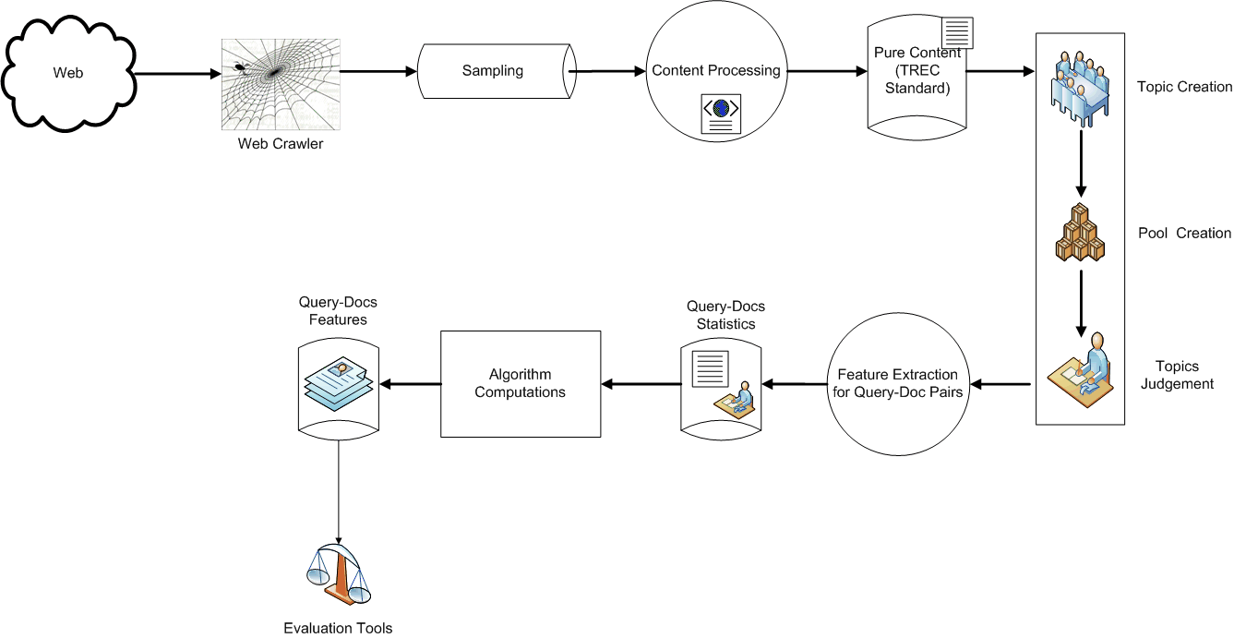
Persian@CLEF Current and Future Research Directions

Slide 18
Persian@CLEF Current and Future Research Directions

Slide 19
Persian@CLEF Current and Future Research Directions

Slide 20
Persian@CLEF Current and Future Research Directions

Slide 21
Persian@CLEF Current and Future Research Directions

Slide 22
Persian@CLEF Current and Future Research Directions

Slide 23
Persian@CLEF Current and Future Research Directions

Slide 24
Persian@CLEF Current and Future Research Directions

Slide 25
Persian@CLEF Current and Future Research Directions

Slide 26
Persian@CLEF Current and Future Research Directions

Slide 27
Persian@CLEF Current and Future Research Directions

