Slide 1
CLEF 2009 Final Session

Slide 2
CLEF 2009 Proceedings
To be published in Springer LNCS (hopefully!)
Deadline for Submission of Papers: 29 November
  Guidelines – see Springer LNCS Instructions for authors
  Papers must be track specific:
    for each group (not Institution): main paper 8 p. max any additional papers – max 4 p.
  Remember LNCS papers are scientific papers – distinct from Working Notes reports
  Submission procedure as last year – information will be circulated by mid-October by Managing Editor: Danilo Giampiccolo
  Details on CLEF website

Slide 3


CLEF 2010
  CLEF 2000 – 2009: central coordination funded by projects under FP5, FP6, FP7
DigiCult Unit
CLEF 2010: No European funding
CLEF 2010: A New Cycle Begins

Slide 4
CLEF 2010
Analyse the results of ten yrs of CLEF
Assess the current state-of-the-art in MLIA domain
Investigate new methodologies and metrics for evaluation
Goal - deeper understanding of interactions between users, contents, languages & tasks.

Slide 5
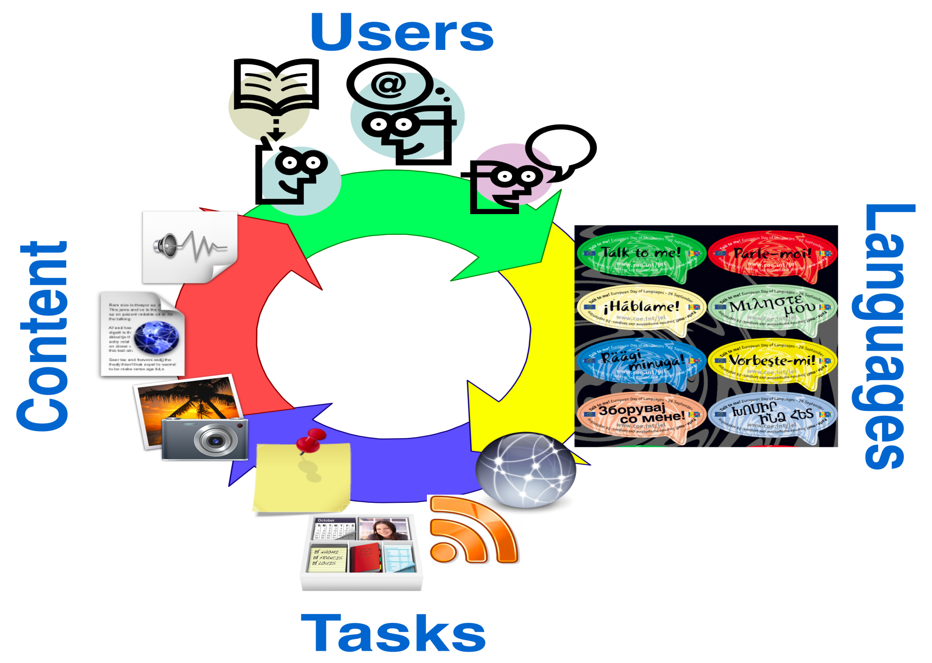

Slide 6
Carol you are wrong again, your slides are finished …. Now we want your song
☺

Slide 7
So Carol come on !!!!

Slide 8
Swan Song
GoodBye to CLEF
OR
Carol leaving Exhausted Friends
Carol Leaving Ecstatic Friends
Carol Leaving Enchanting Friends
Carol Leaving Exceptional Friends
Carol Leaving Eternal Friends
Carol Leaving Everlasting Friends

Slide 9
As you know - I’m sorry to go
CLEF for me
Has been trouble and strife
CLEF for me
Has been a big part of my life
CLEF for me
A million fights
CLEF for me
Amazing heights
CLEF for me
A community growing
Can it be?
I’m really going?

Slide 10
But I know, I leave you all
In very good hands, you’ll have a ball
CLEF TwentyTen, is an important date
It’ll be a success, it will be just great
It’s a new adventure, a challenging task
I’ll be thinking of you, while in sun I bask
And every so often, at the end of the day
I will ask myself, what’s happening at CLEF?

